Slide 1
Uncertainty-Aware Graph Neural Network
for Dynamic NOMA User Grouping under Imperfect CSI
Semi-Supervised Learning Approach
Rahul Bodduna - 2520040002
Harishwar Reddy Mogiligari - 2520040015
Akshay Boppudi - 2520040029
Imperfect CSI
User Graph
Semi-Supervised GNN
NOMA + SIC
1

Slide 2
1. Background & Key Concepts
Why CSI, NOMA, SIC and GNNs are connected
CSI
Imperfect CSI
NOMA
SIC
Channel State Information describes the wireless channel between the base station and each user. True CSI is difficult to know perfectly.
Estimated CSI contains errors due to noise, feedback delay, estimation error and channel variation. This creates uncertainty.
Multiple users share the same time-frequency resource using superposition coding and power allocation.
Successive Interference Cancellation decodes users sequentially and subtracts decoded signals.
Users
Estimated CSI
User Graph
GNN
Groups
• The project combines wireless communication modeling with graph-based machine learning.
• Goal: learn grouping decisions while explicitly considering CSI reliability.
2

Slide 3
2. Problem Statement & Objective
Target problem and technical challenges
Target problem
Learning problem
A base station serving many mobile users must decide which users should share NOMA resources as channel conditions change over time.
Obtaining optimal/reference group labels for every channel realization is computationally expensive. Much of the generated wireless data can remain unlabeled.
Technical problem
Research objective
Grouping based on inaccurate CSI can produce unsuitable pairings, higher interference and incorrect SIC decoding assumptions.
Develop a semi-supervised, uncertainty-aware GNN that learns dynamic NOMA grouping using a small labeled set and a larger unlabeled set.
3

Slide 4
3. Proposed Methodology
Semi-supervised uncertainty-aware graph learning
Wireless
Users
Estimated CSI
+ uncertainty
User
Graph
GNN
Embeddings
Dynamic
NOMA Groups
Labeled branch
Unlabeled branch
Combined objective
Reference labels are available for only a subset of training graphs.
L_sup = Cross-Entropy(reference, prediction)
Two perturbed views of an unlabeled graph should give consistent predictions.
L_cons = D(P1, P2)
Train using:
L = L_sup + λL_cons
High-confidence predictions may become pseudo-labels.
• Node features: estimated channel gain + CSI uncertainty.
• Edges: channel similarity / interference relationship.
4

Slide 5
4. Semi-Supervised Learning Algorithm
How labeled and unlabeled channel graphs are used
Labeled
subset
GNN + CE
L_sup
Generated graphs
Total loss
L_sup + λL_cons
Update GNN
Unlabeled
subset
GNN + perturbation
L_cons
Confidence-aware pseudo-labeling
Why this helps
If prediction confidence is high and CSI uncertainty is low, accept the prediction as a pseudo-label. Low-confidence/high-uncertainty samples are ignored.
A small labeled set provides reliable supervision while the large unlabeled set contributes through consistency and selected pseudo-labels.
5

Slide 6
5. Project Workflow / Implementation
End-to-end simulation and ML pipeline
Generate users
Generate true CSI
Add CSI error
Build user graph
SINR / rate evaluation
Power allocation + SIC
Predict dynamic groups
Train semi-supervised GNN
Final outputs
Dynamic groups • SIC order • SINR • individual rate • sum rate • fairness • outage • grouping accuracy
6

Slide 7
6. Experimental Design
Planned simulation configuration
Wireless model
Learning setup
Baselines
• 20 users
• 4 NOMA groups
• Rayleigh fading
• AWGN noise
• Variable SNR
• Variable CSI-error variance
• PyTorch + PyTorch Geometric
• Small labeled subset
• Large unlabeled subset
• GNN node classification
• Consistency loss
• Confidence-based pseudo-labels
• Random grouping
• Channel-based grouping
• K-Means
• Supervised GNN
• Semi-supervised GNN
• Proposed uncertainty-aware model
Main experiments
1. Sum rate vs SNR
2. Sum rate vs CSI uncertainty
3. Outage probability vs SNR
4. Jain fairness vs CSI uncertainty
5. Grouping accuracy vs labeled-data percentage
6. Compare supervised vs semi-supervised learning
• Test data must remain unseen during training and pseudo-label generation.
• Use multiple random channel realizations and report averaged results.
7

Slide 8
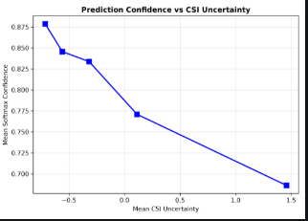
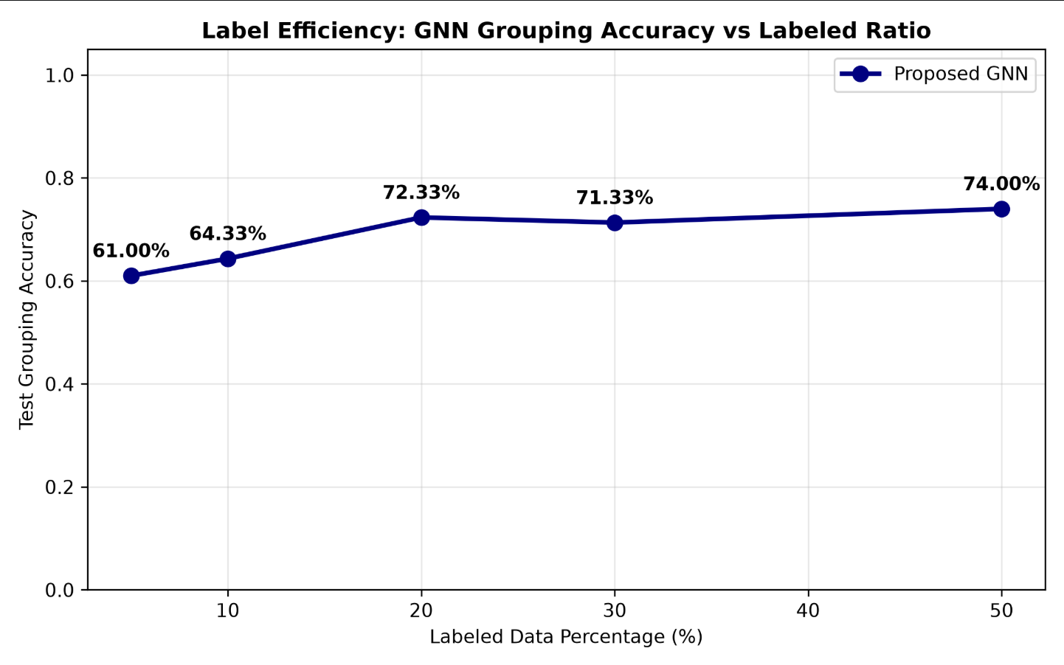
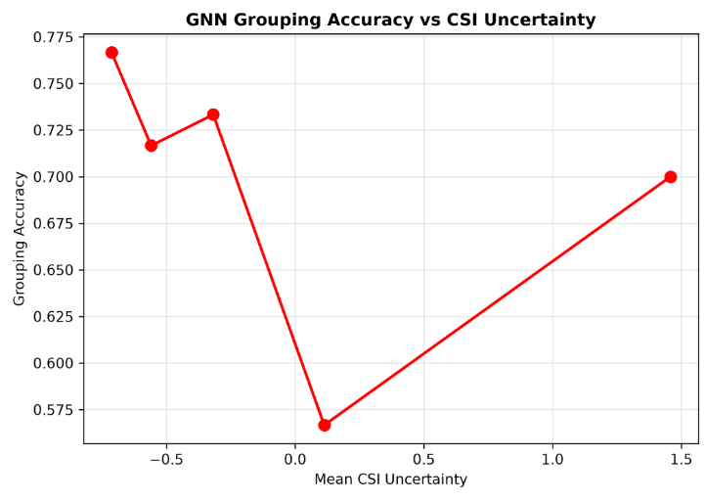
7. Simulation / Experimental Results
Result presentation plan — numerical results will be filled after implementation
Prediction
Accuracy vs Labeled Data
Rate vs CSI Uncertainty
• Do not fabricate numerical performance values before the simulator is run.
• Expected analysis: robustness to CSI error and label-efficiency of semi-supervised learning.
• Final comparison should use the same test scenarios for every baseline.
8

Slide 9
8. Current Progress & Remaining Work
Development status
Current progress
Remaining implementation
✓ Project title and research objective finalized
✓ CSI / imperfect CSI concepts understood
✓ NOMA and SIC mechanism defined
✓ Semi-supervised approach selected
✓ Graph representation defined
✓ Uncertainty-aware node features defined
✓ Supervised + consistency loss framework planned
✓ Baselines and evaluation metrics identified
□ implementing on real-world dataset
9

Slide 10
9. Expected Contribution & Conclusion
1. Semi-supervised learning
2. Uncertainty awareness
3. Dynamic grouping
Use a small labeled set plus a larger unlabeled wireless dataset to reduce dependence on expensive grouping labels.
Represent CSI reliability explicitly so channel estimation errors are considered during grouping.
Adapt NOMA user groups to changing channel conditions, then evaluate SIC, SINR and rate.
Imperfect CSI
Graph + GNN
NOMA Groups
SIC → Rate
Final objective: quantify grouping performance and robustness under imperfect CSI while reducing the amount of labeled training data.
10

